Slide 1
STUDENT PERFORMANCE MONITORING SYSTEM
CSE303: DATABASE MANAGEMENT
SYSTEM

Slide 2
GROUP 3
SHANAZ RAZIA FIDDA: 1731389
MD. TAREK AZIZ: 1730050
MD. ZAHIDUL ISLAM: 1721883
TOUFIQ AHMED NILOY: 1631281
BM FAHIM ABRAR: 1630263
SHAHNEWAZ MUHAMMAD RAJIT: 1630736
MAHFUZUR RAHMAN: 1811077

Slide 3
CONTENT
CHAPTER 1: INTRODUCTION
CHAPTER 2: REQUIREMENT ANALYSIS
RICH PICTURE (AS-IS)
SIX ELEMENTS (AS-IS)
PROCESS DIAGRAM (AS-IS)
PROBLEM ANALYSIS
RICH PICTURE (TO-BE)
SIX ELEMENTS (TO-BE)
PROCESS DIAGRAM (TO-BE)
CHAPTER 3: LOGICAL SYSTEM DESIGN
BUSINESS RULE
ENTITY RELATIONSHIP DIAGRAM

Slide 4
Chapter 1: Introduction
Our goal is to deliver a project that will design and build to help universities to promote a productive way for student performance monitoring system. We intend to provide a wholesome experience for students, faculties, head of departments and all the higher authorities. This application is a one-stop place for students to track their progress, for faculties to track course curriculum and all the higher authorities to monitor quality of education provided. We have added features to track students CGPA trend and sleeker way of workflow. This application gives the power to generate new student accounts much faster

Slide 5
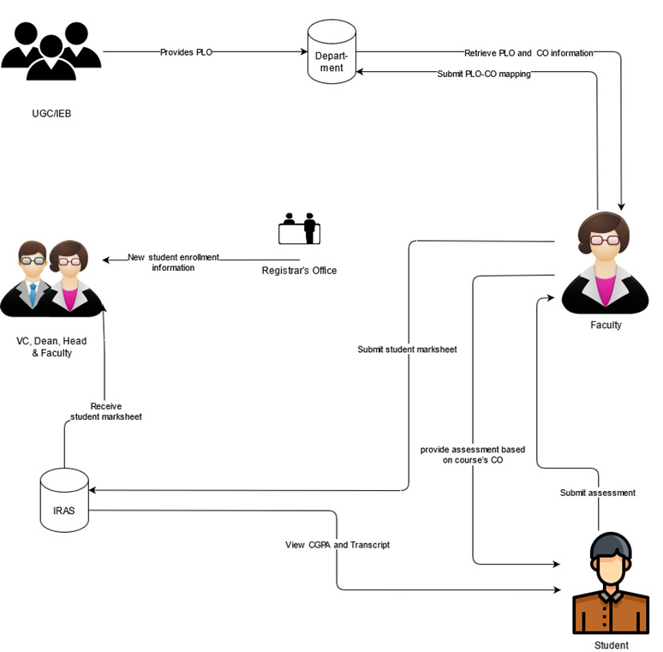
Chapter 2: Requirement Analysis RICH PICTURE (AS-IS)
Figure: Rich Picture As-Is

Slide 6
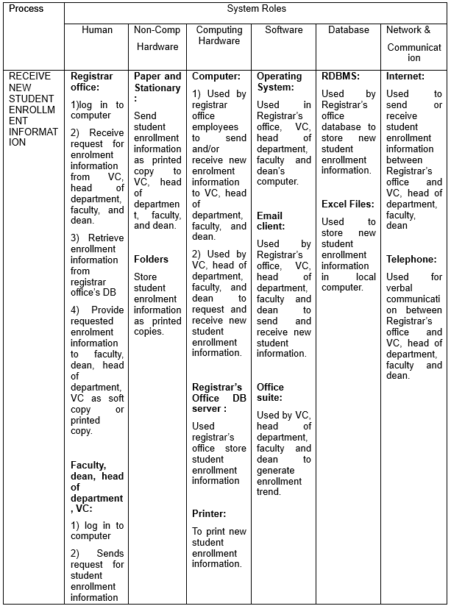
SIX ELEMENTS (AS-IS)

Slide 7
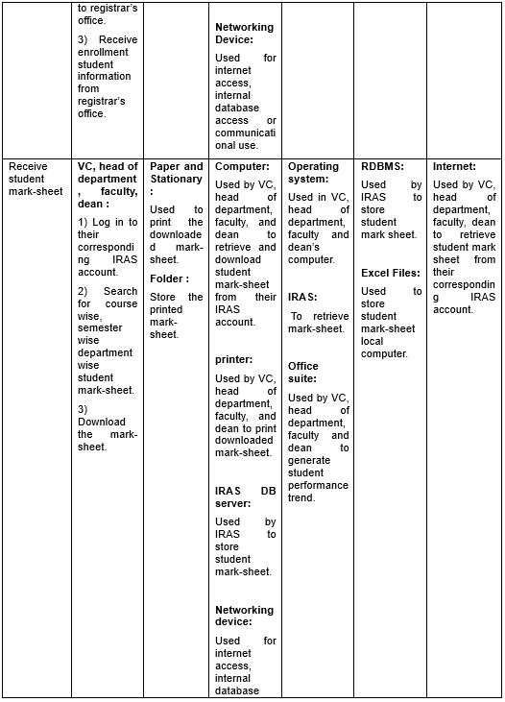

Slide 8
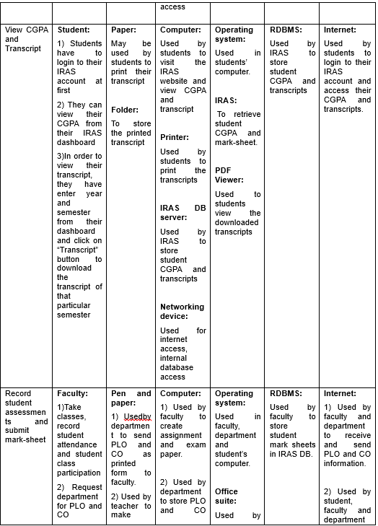

Slide 9
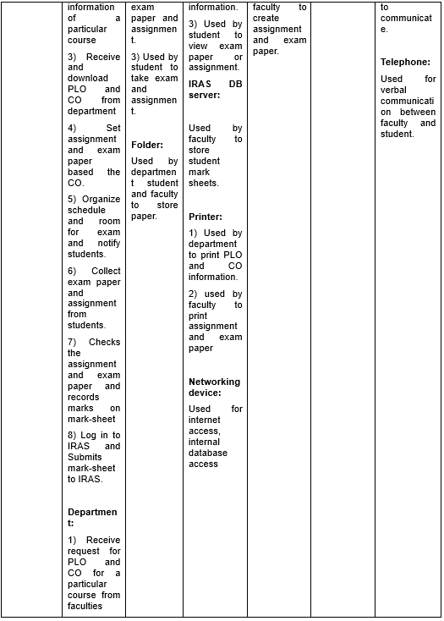

Slide 10
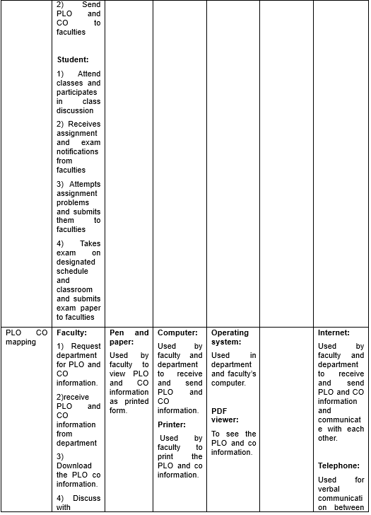

Slide 11
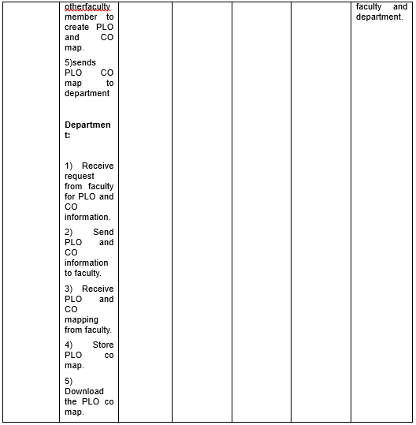

Slide 12
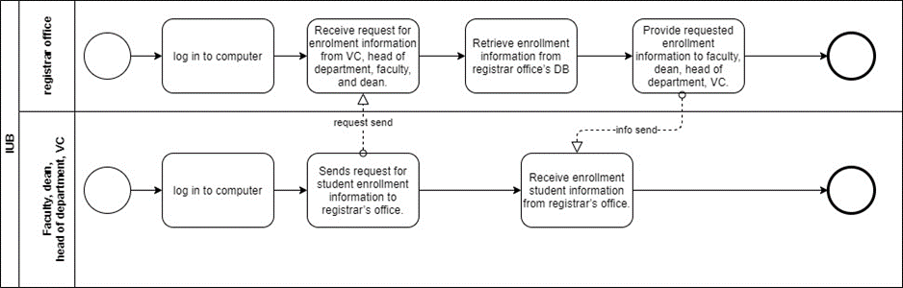
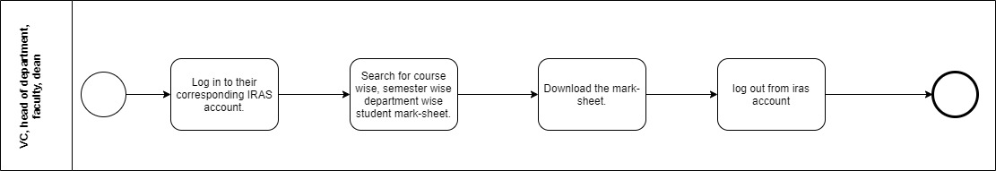
BUSINESS PROCESS DIAGRAM (AS-IS)
BPMN (AS-IS) FIGURE 1: View new enrollment data
BPMN (AS-IS) FIGURE 2: View Student Mark-sheet by VC, Dean, Head, and Faculty

Slide 13
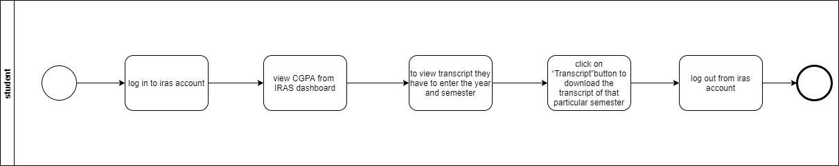
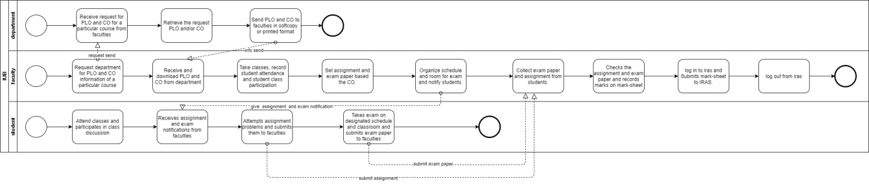
BPMN (AS-IS) FIGURE 3: View Transcript by Students
BPMN (AS-IS) FIGURE 4: Record Student Assessment

Slide 14
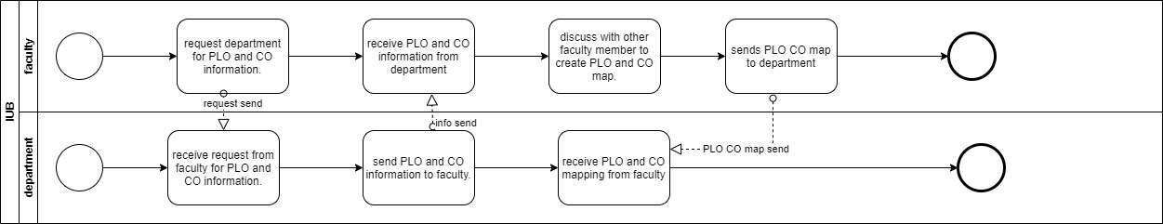
BPMN (AS-IS) FIGURE 5: Map PLO to CO

Slide 15
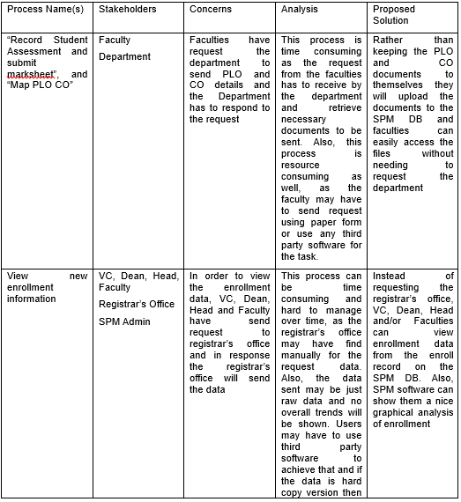
PROBLEM ANALYSIS

Slide 16
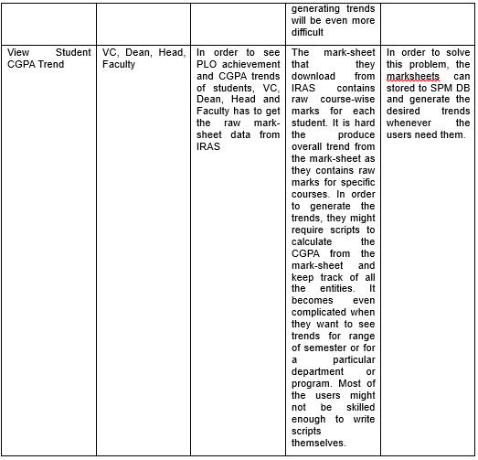

Slide 17
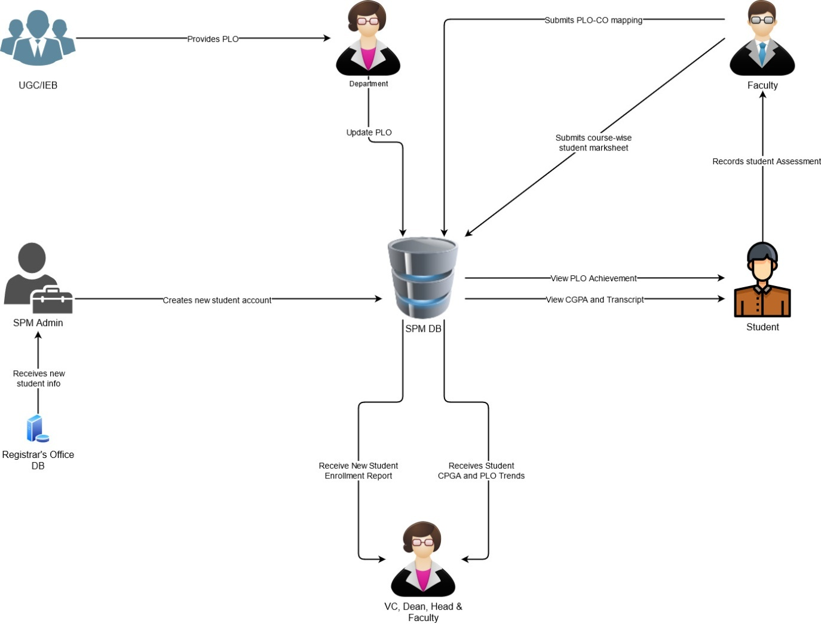
RICH PICTURE (TO-BE)
Figure: Rich Picture TO-BE

Slide 18
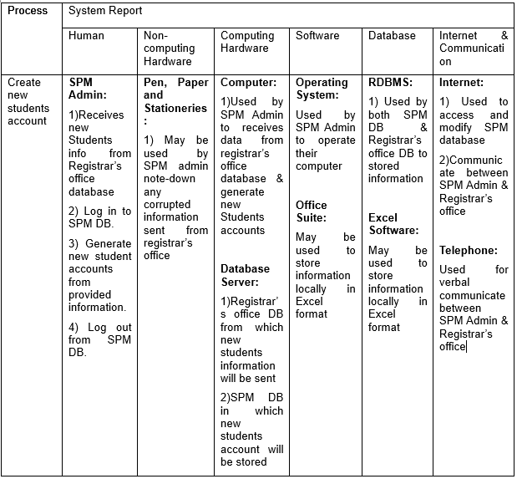
SIX ELEMENT ANALYSIS (TO-BE)

Slide 19
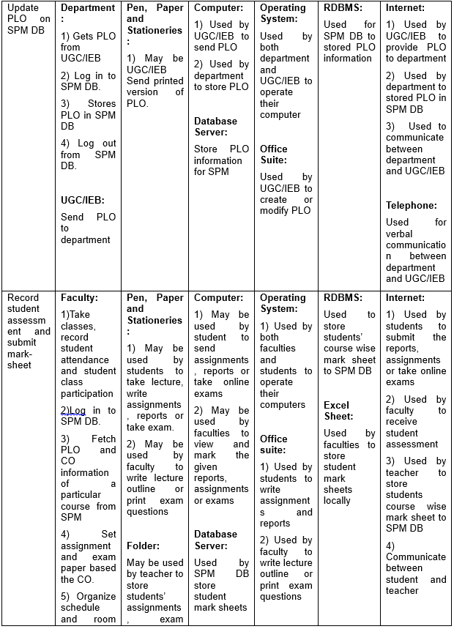

Slide 20
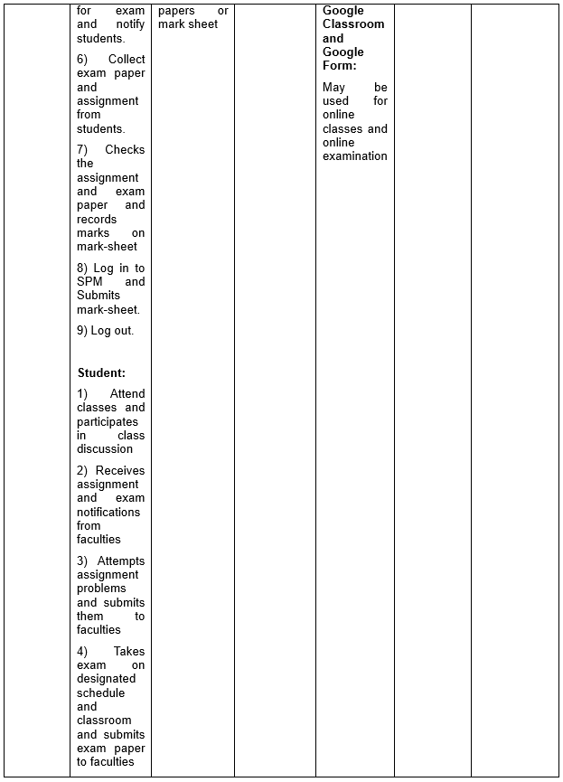

Slide 21
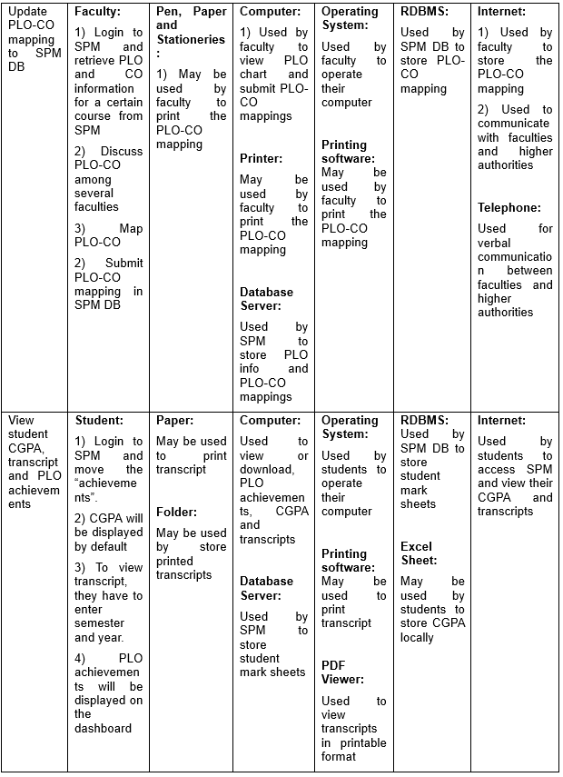

Slide 22
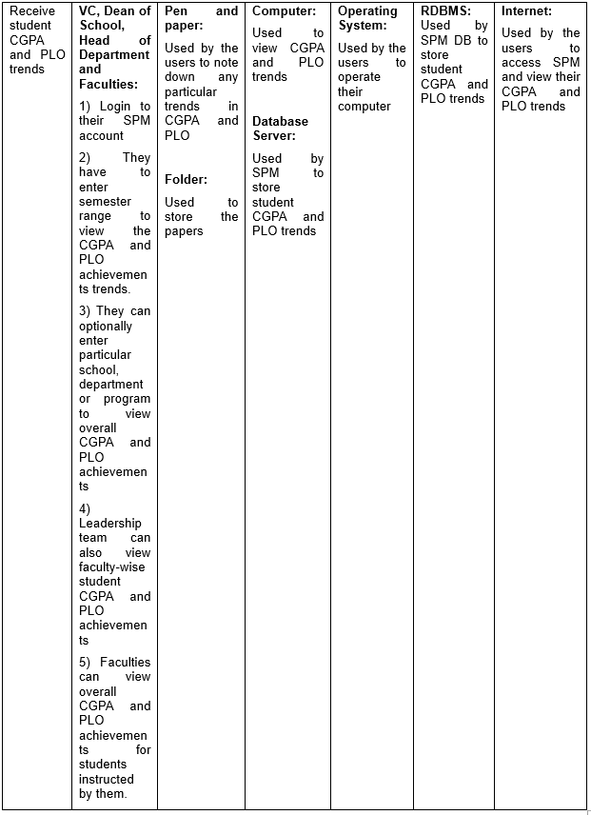

Slide 23
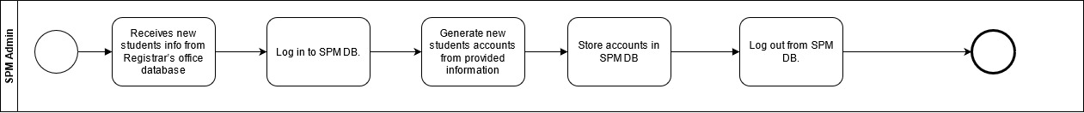
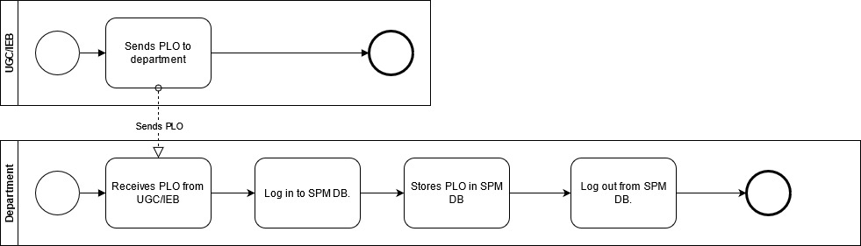
BUSINESS PROCESS DIAGRAM (TO-BE)
BPMN (TO-BE) FIGURE 1: Create new studentaccount
BPMN (TO-BE) FIGURE 2: Update PLO on SPM DB

Slide 24
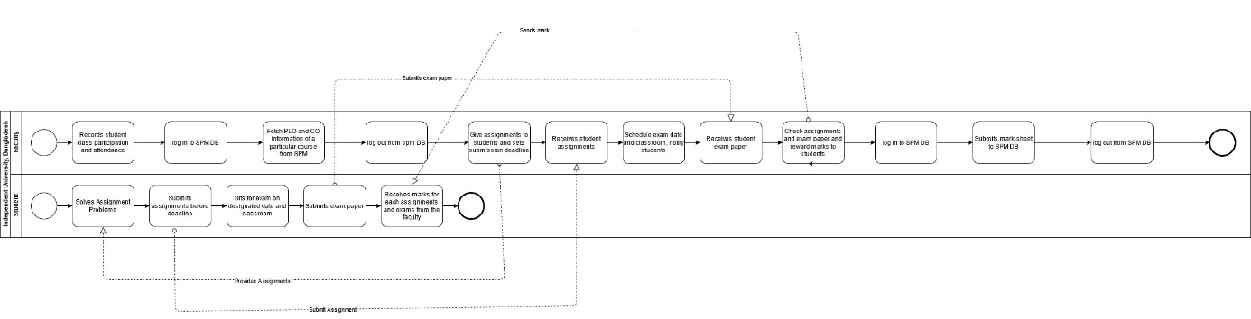
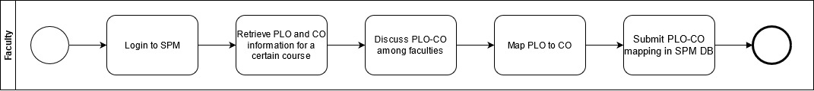
BPMN (TO-BE) FIGURE 3: Record student assessment and submit mark-sheet
BPMN (TO-BE) FIGURE 4: Update PLO-CO mapping to SPM DB

Slide 25
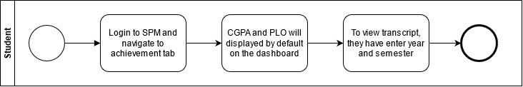
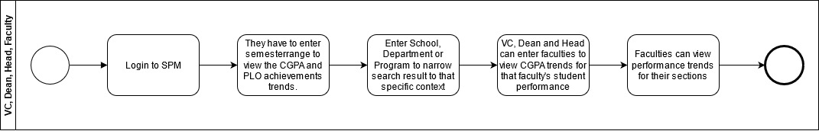
BPMN (TO-BE) FIGURE 5: View student CGPA, transcript and PLO achievements
BPMN (TO-BE) FIGURE 6: Receive student CGPA and PLO trends

Slide 26
Business Rule
A department is enrolls multiple students. Each student is enrolled by exactly one department. A department must belongs to exactly one school. A school is consist of many department. A department must have exactly one head of department. A head of department is belongs to exactly one department. A department must employee many faculty. A faculty is employed by exactly one department. A student is enrolls to exactly one section. Each section must have many students. A faculty is assign to many section. A section must have exactly one faculty. A course is assign to many section. A section must contains exactly one course. A section may assign many assessment. Each assessment is assign by exactly one section. An assessment is assign to many student. Each student must receive many assessment. An assessment must have multiple Cos. A CO is belongs to exactly one assessment. A CO is belongs to exactly one course. A course must have many Cos. A CO is belongs to exactly one PLO. A PLO must have many CO’s. A PLO is stored by exactly one department. A department must store many PLOs. A PLO is contain by exactly one program. A program must consist of many PLOs. A program is enrolls many student. Each student is enrolled by exactly one program. A program must belongs to exactly one department. A department is consist of many program. A school must have exactly one dean of school. A dean of school is belongs to exactly one school. A school must belongs to exactly one university. A university is consist of many school. A university must have exactly one VC. A VC is belongs to exactly one university.

Slide 27
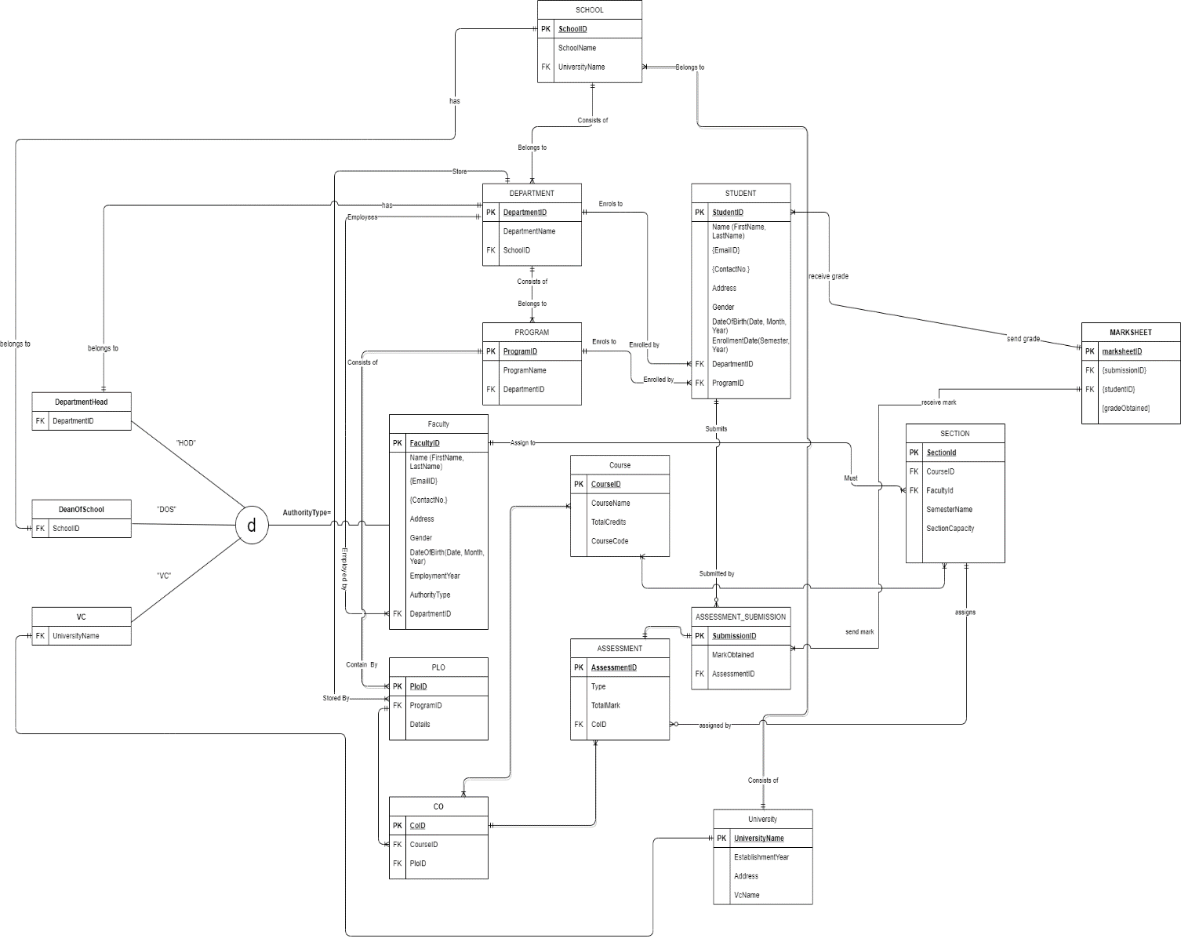
A student may submit many assessment answer. An assessment answer must submitted by exactly one student. A student must receive grade from exactly one mark sheet. A mark sheet must send grade to many students.
ERD

Slide 28
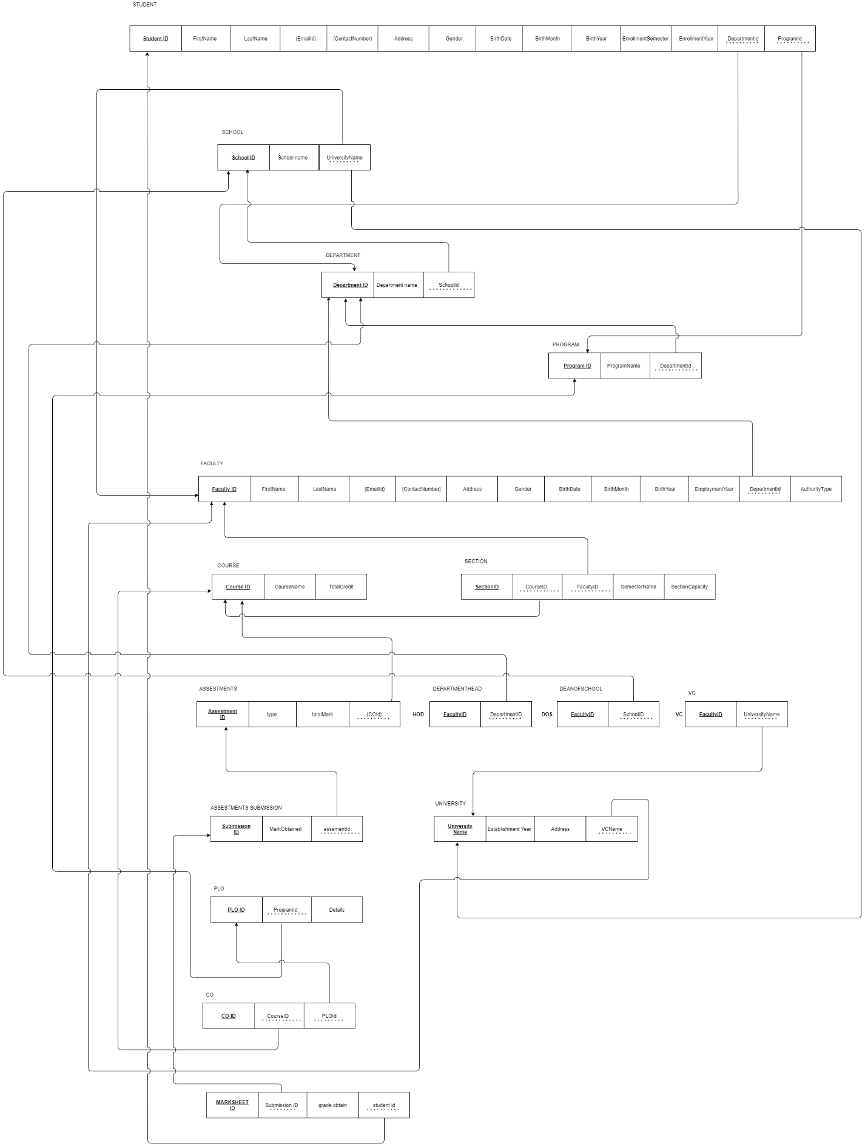
RELATIONAL SCHEMA

Slide 29
NORMALIZATION
1NF: In the schema we need to remove all the multivalued attributes.
2NF: In this schema there will be no partial dependencies.
3NF: In this schema we have to remove transitive dependencies.
BCNF: Remove remaining anomalies resulting from multiple candidate keys.

Slide 30
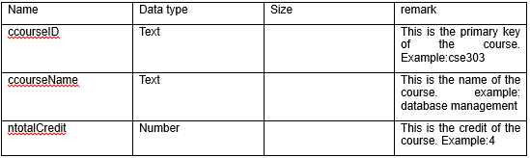
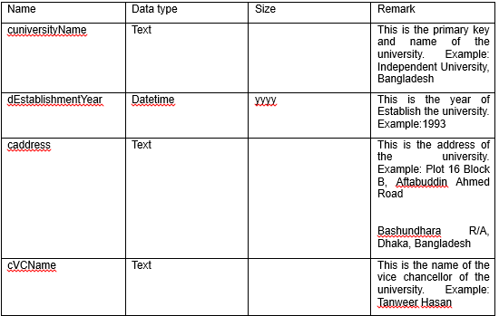
DATA DICTONARY:
tblcourse
tbluniversity

Slide 31
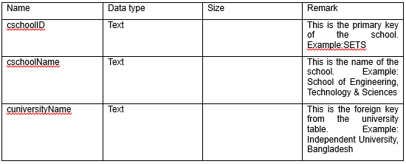
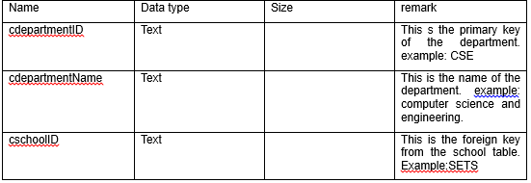
tblschool
tbldepartment

Slide 32
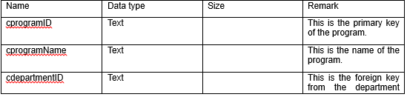
tblprogram

Slide 33
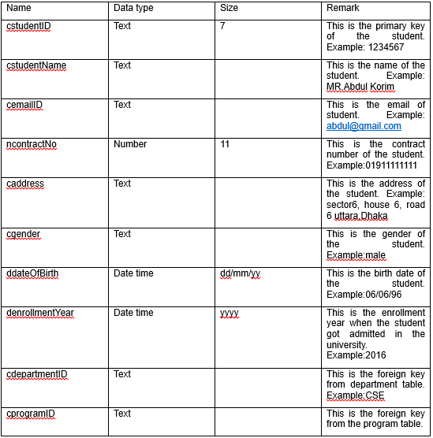
tblstudent

Slide 34
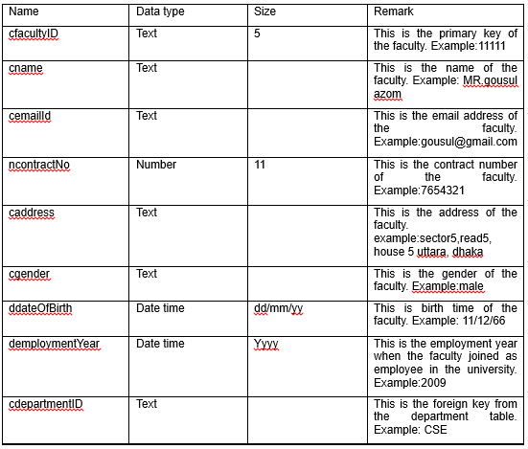
tblfaculty

Slide 35
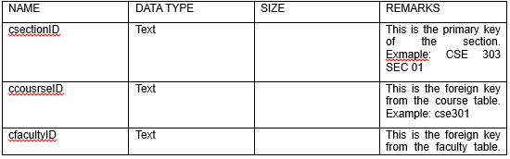
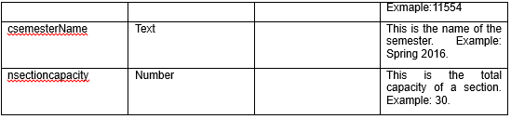
tblsection

Slide 36
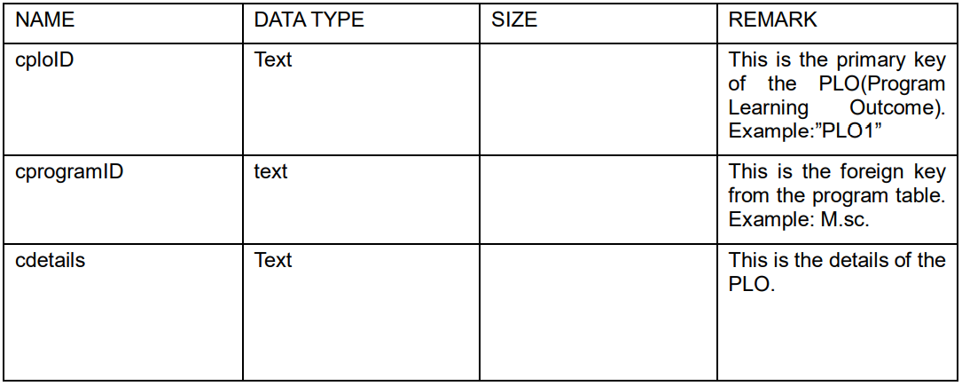
tblplo

Slide 37
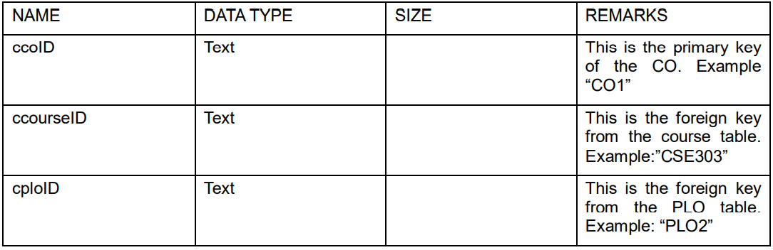
tblco

Slide 38
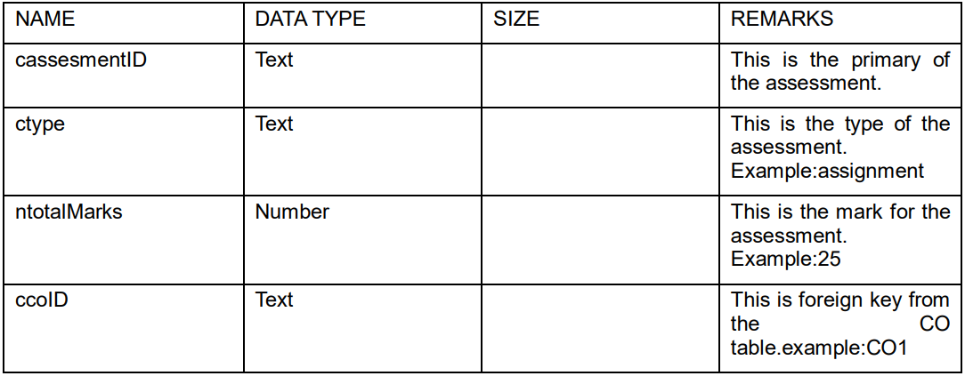
tblassessmentID

Slide 39
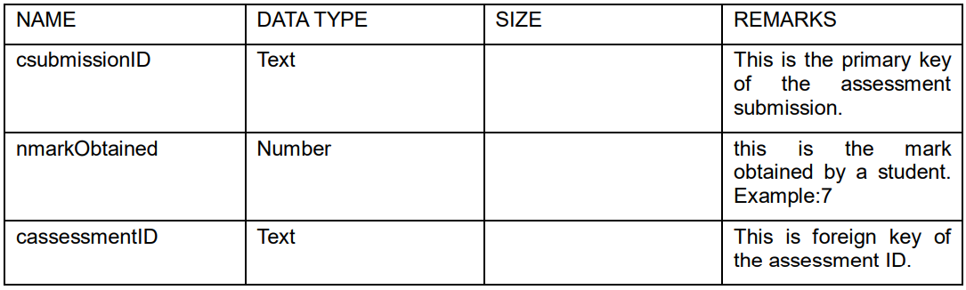
tblassessment submission

Slide 40
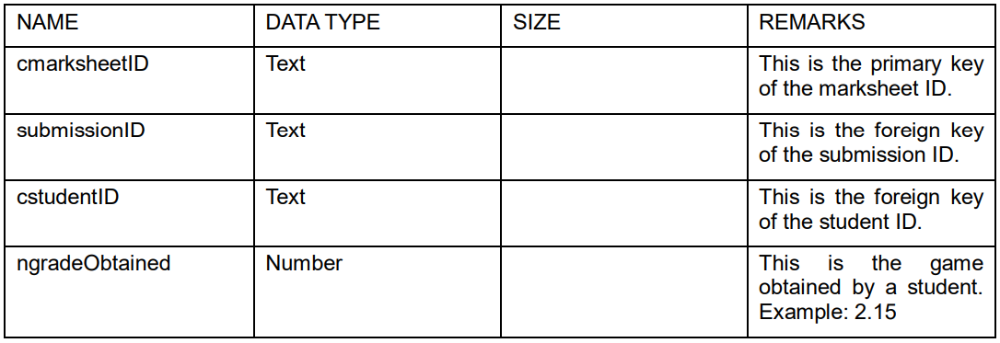
tblmarksheet

Slide 41
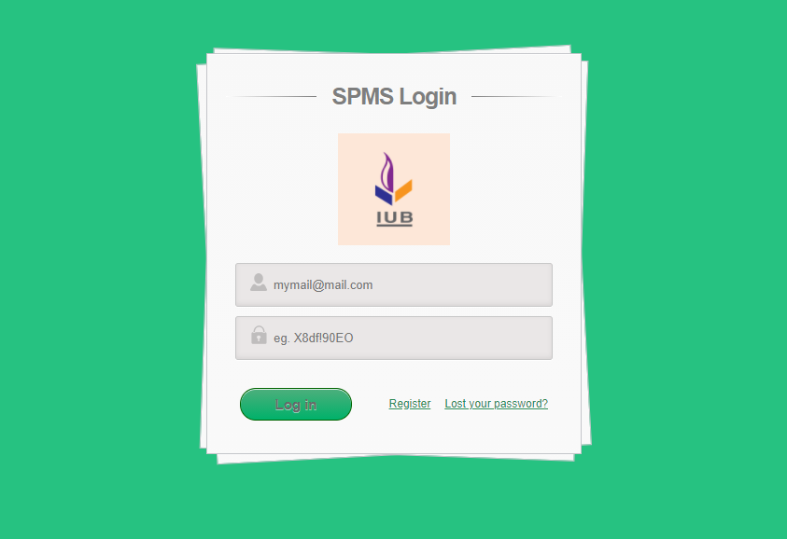
LOGIN INTERFACE

Slide 42
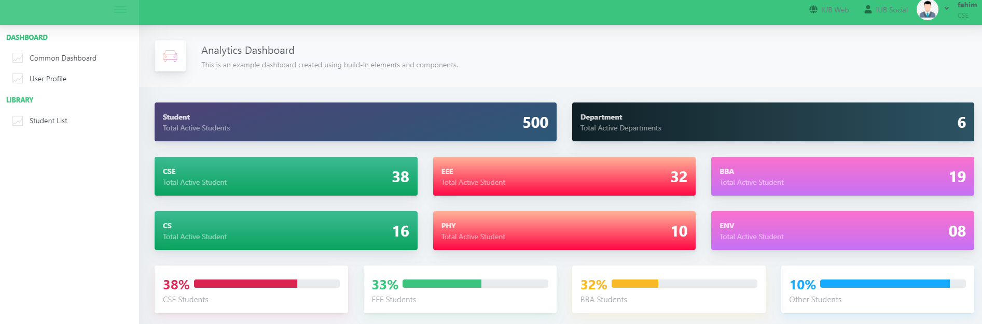
ANALYTICS DASHBOARD

Slide 43
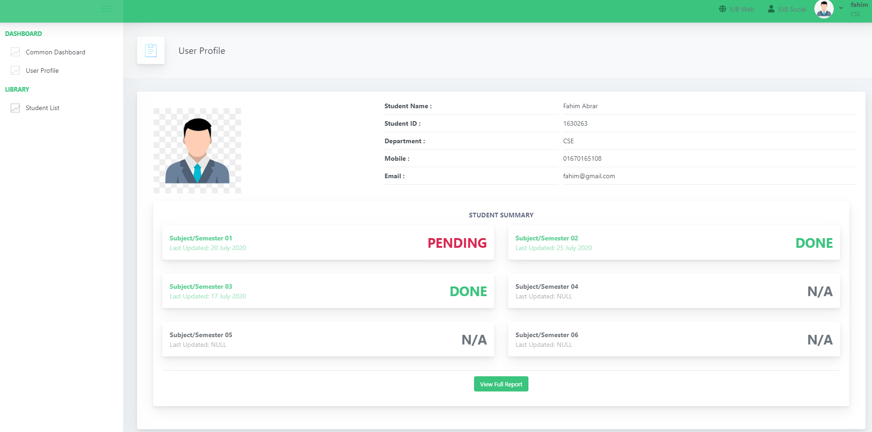
USER PROFILE

Slide 44
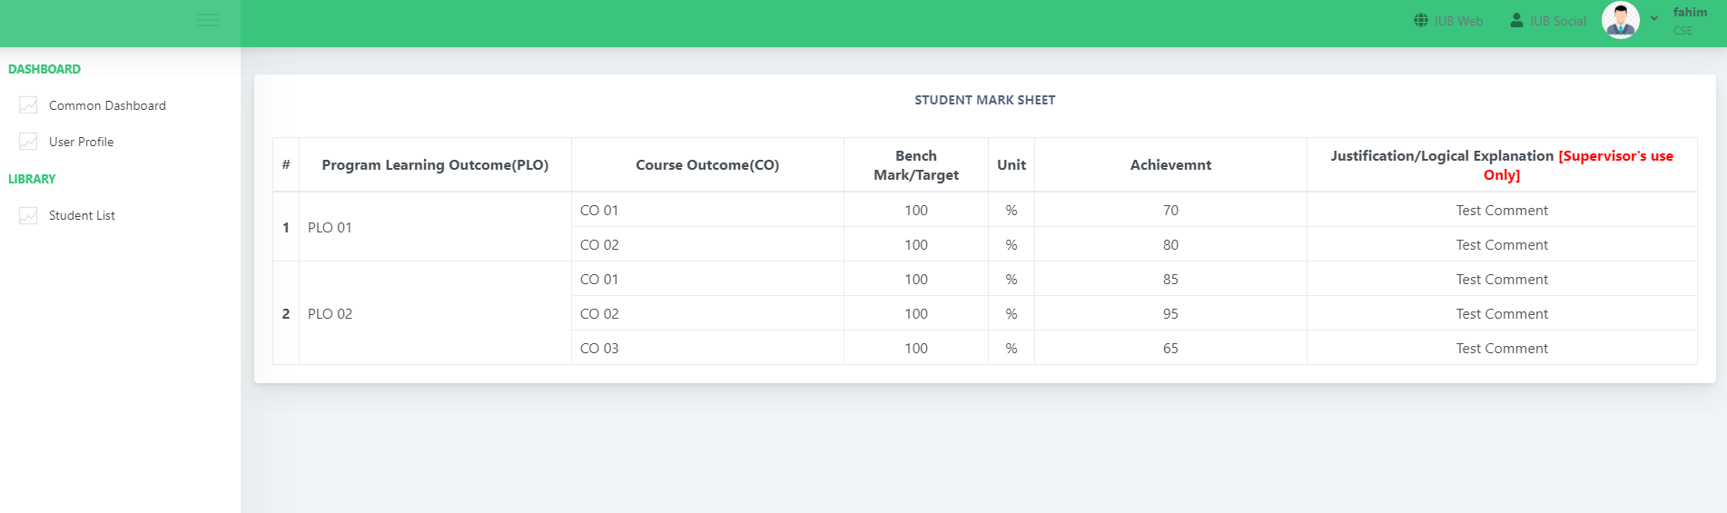
STUDENT MARKSHEET

